Slide 1
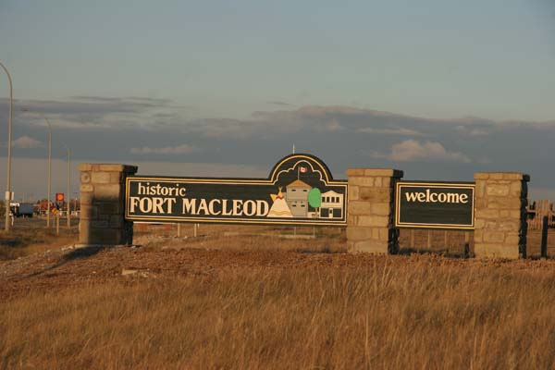
Social Inclusion/Exclusion: Low-income Parents, Grandparents & Children Participating in Community Development in Rural Alberta
Sharon Yanicki
Nov. 27 2015
Acknowledgement: This research was supported by funding from:
the Canadian Nurses Foundation, the Alberta Registered Nurses
Educational Trust & the University of Lethbridge
Notes:
I’m please to provide a brief overview of my dissertation research. I’d like to acknowledge that this research was supported through funding from the CNF,
ARNET and the U of L.
Picture: Fort Macleod:
https://www.google.ca/search?q=fort+macleod+pictures&biw=1440&bih=770&tbm=isch&tbo=u&source=univ&sa=X&ved=0ahUKEwiTg_O4xKLJAhUClYgKHeghAJwQsAQIGw&dpr=1

Slide 2
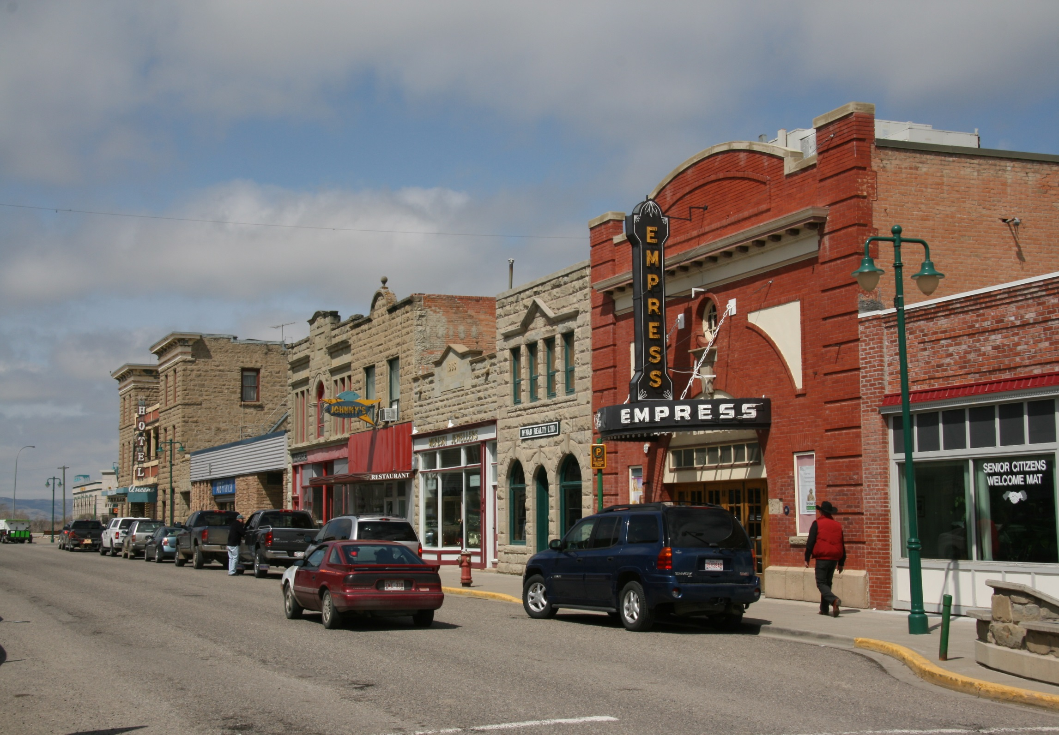
Study Setting
Fort Macleod, Alberta
Notes:
This study took place in Fort Macleod, a historic town located near two First Nations communities.
Picture Fort Macleod: http://www.fortmacleod.worldweb.com/

Slide 3
Purpose and Research Questions
The purpose of this critical ethnographic study was to explore social inclusion/exclusion (SI/SE) in a rural Alberta community
Research questions:
How was SI/SE experienced by parents and grandparents with young children participating in the programs and activities of a rural Family Centre?
What processes and conditions enabled or constrained the participation of and social inclusion of low-income and Aboriginal parents, grandparents and children?
What strategies encouraged the participation and inclusion and addressed the exclusion of low-income and Aboriginal parents, grandparents and children?
How did social, economic and political conditions influence Family Centre strategies to encourage participation and to address SI/SE?
Notes:
See the first and second research questions on page 16 (introduction section) and page 120 (chapter IV, paper 3) of the dissertation.
The first research question was explored from the perspective of parents and grandparents participating in the Kids First Family Centre in Fort Macleod Alberta.
The second research question was explored from the perspective of key informants (leaders, employees and volunteers).

Slide 4
Focus: Key Findings and Contributions
Conceptual/Philosophical
Three Canadian discourses on SI/SE
An Integrated Framework for Social (In)Justice
Empirical
Relational patterns, transitions & inclusion
Key strategies to promote participation & address SI/SE
The influence of context on Family Centre strategies
Methodological
The integration of content analysis with critical hermeneutic analysis in a critical ethnographic study
Notes:
Key findings and contributions will be highlighted in three areas:
Conceptual/Philosophical
Empirical
Methodological

Slide 5
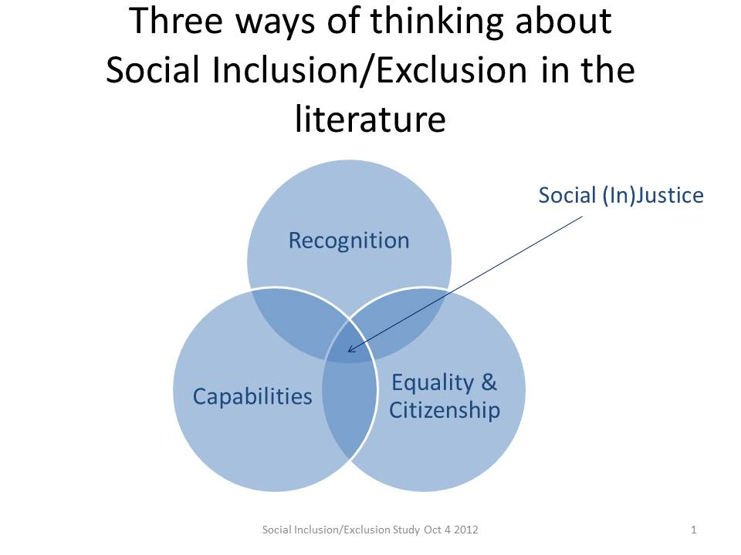
Chapter II (Paper 1)
Three Discourses on SI/SE in
Canadian Literature
(Yanicki, Kushner, & Reutter, 2015)
Notes:
Three Canadian discourses on SI/SE were identified in a review of literature from nursing, public health, development and political economy.
Social justice is at the heart of the just social relations and societal conditions enabling inclusion.

Slide 6
Integrated Framework for Social Justice
(Yanicki, Kushner, & Reutter, 2015)
Notes:
The Integrated Framework for Social Justice provides:
- a broad framework for addressing the relational and structural dimensions of social justice. It includes:
Integration of three discourses on SI/SE and different strategies to promote inclusion and to address the root causes of exclusion as matters of social (in)justice
A socioecological perspective
A focus on multiple levels of intervention
A critical perspective

Slide 7
Chapter III (Paper 2) Three Relational Patterns
Newcomers
Boundary Crossers
Permanent Strangers
>40%
Choosing to
participate in
mixed groups
<30%
Choosing not to
participate/ Gaining a provisional sense of belonging
<30%
Seeking to belong
Notes:
Low-income and Aboriginal parents and grandparents were included in all three relational patterns.
Participation differed by relational pattern:
Permanent Strangers – participating in a community kitchen provided a sense of belonging in a group (often provisional).
Newcomers – participating in children’s programs or church-based activities provides a sense of group belonging.
Boundary Crossers – participating informal programs with mixed groups and school-based activities, contributing, leader or volunteering supports community belonging and from some a sense of community inclusion.

Slide 8
What Supported Relational Transitions?
Internal
Shift
Change in Relationships
Change in the Environment
Transition experiences involved:
An internal shift in
awareness, attitudes, interests,
self-perception, or identity
Transitions in Relational Patterns were linked to:
Changes in relationships
Changes in the environment
Notes:
Transitions and a progression toward greater participation and changes in relational patterns were identified by a few participants.
Changes in relationships – e.g., outreach contacts
Changes in the environment – e.g., opportunities for participation in accessible, acceptable programs.
Internal shifts followed.
For examples see pages 106 – 110 of the dissertation.

Slide 9
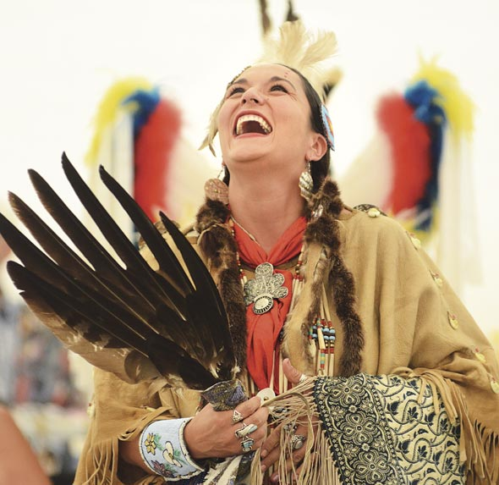
Chapter IV (Paper 3) What Supported Inclusion or Sustained Exclusion? Analysis of Parent & Grandparent Interviews
Relational Inclusion
Cultural Inclusion
Relational Exclusion
Cultural Exclusion
Moral Exclusion
Material Exclusion
Notes:
Two forms of inclusion and three forms of exclusion were identified from parent and grandparent interviews:
Relational inclusion involved having opportunities to engage in affirming social interaction, feeling values and recognized and having a sense of belonging (in a group, or in the community). (See pages 111-112.)
Supports for relational inclusion: - Outreach contacts and participation in Family Centre programs and activities supported relational inclusion, however the patterns of participation were different for each of three relational patterns.
Cultural inclusion meant having opportunities for valued cultural participation and feeling respected for one’s cultural identity. (See pages 112 – 113.)
Supports for cultural inclusion: - Participating in: culturally acceptable programs and valued cultural activities supported the inclusion of Aboriginal participants.
Relational exclusion involved choosing not to participate, feeling left out of existing social networks, or feeling isolated. (See pages 113-114.)
Cultural exclusion involved having limited opportunities for cultural participation or cultural exchange and contribution. (See pages 114-115.)
Moral exclusion involved feeling judged, devalued, or censored by others for deviance from social norms and the characteristics of the dominant group in the community. (See pages 115-116.)
Material exclusion involves lacking opportunities to earn an adequate income, being unable to meet basic needs, or being unable to participate in desired activities due to economic constraints. (See page 117).
Picture: Rachel Crowspreadingwings of the Kainai Nation (Blood Tribe) http://www.columbiavalleypioneer.com/?p=6877

Slide 10
Participation & Different Meanings
Forms of participation*
Nonattendance
Attendance
Comfortable participation
Diverse participation
Meaningful participation
*Viewed as a progression from one form to another form of participation
Meanings
“People who aren’t here but could be participating.”
Using “programs that are free”.
Programs and social spaces that enable people to “feel safe and comfortable”.
Mixed groups with people from varied income, ethnocultural background, age and gender.
Contributing to, leading, influencing decisions, or volunteering

Slide 11
Key strategies – Analysis from Key Stakeholders Interviews
Strategies to enable participation and inclusion:
Building trust and positive interactions
Creating opportunities for multiple forms of participation
Providing accessible, culturally acceptable & safe programs
Promoting diverse participation in free universal programs
Building capacity & intersectoral collaboration
Promoting an inclusive & welcoming community
How?
a) Outreach worker contacts
b) Creating safe social spaces, programs & community events with partners
Places to meet
Volunteer/Contribute
c) Traditional First Nations
activities
Universal programs
d) Creating mixed groups to bridge
difference
e) Community development
Mobilizing action & intersectoral partnerships (Community Capacity Building)
Social action*
f) Influencing community
Awareness & attitudes (dialogue, workshops, & training)
Appreciation & respect (FN culture)
*Starred activities were dropped after becoming a registered charity.
Notes:
How did key informants describe the strategies used to enable participation and inclusion? A wide range of strategies were described from the initial development of the coalition to address child poverty to the development of a society, the merger between the Parent Link Centre and the Kids First Society and development of the Kids First Family Centre.
The six strategies listed here involved a focus on building trusting relationships, creating new opportunities for participation, receiving support and taking part (e.g., programs, activities, and safe welcoming social spaces), mobilizing action with community partners, and influencing community awareness, attitudes, cultural appreciation & respect for First Nations culture and identity.

Slide 12
Key strategies – Analysis from Key Stakeholders Interviews
Strategies to reduce barriers and address exclusion:
Reducing financial barriers for children’s participation and relieving poverty and food insecurity
Reducing poverty stigma by linking families to programs and resources
Reducing racism and discrimination by supporting respect for diversity
How?
a) Increasing access to local & external
resources
Program grants
Recreation subsidies
Local fundraising
b) Universal programs:
School feeding programs
Building community support
c) Advocacy*
Media articles
Bottom-up approaches
Youth-led social inclusion project
Town resolution (CMARD)
*Starred activities were dropped after becoming a registered charity.

Slide 13
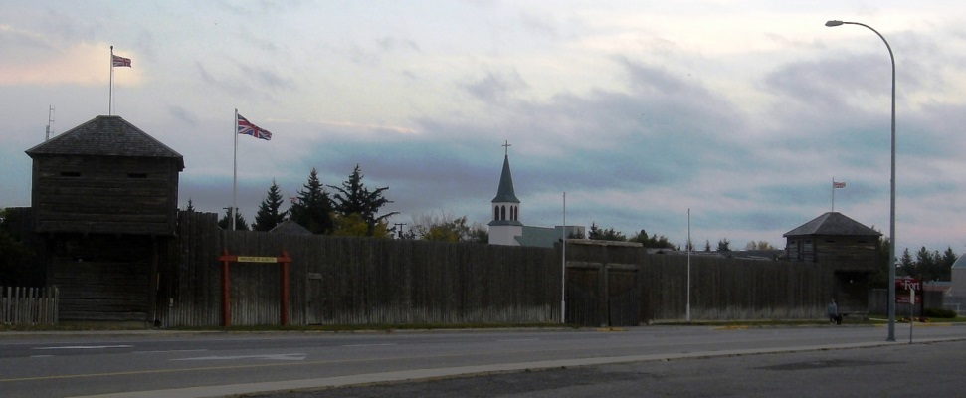
Social Context Influences on Family Centre Strategies
During a period of fiscal constraint:
Gaining registered charity status
Program discourse
Normative claims focused on:
meeting local needs
universality
interactions across difference
local leadership
Notes:
Reflecting on the value of critical hermeneutic analysis in this study:
- The analysis helped to uncovered Family Centre values that had not previously been made explicit and to identify conflicts with dominant discourse, unexamined valued and constraints within the policy context.
Picture: The NWMP Fort in Fort Macleod:
https://www.google.ca/search?q=fort+macleod+pictures&biw=1440&bih=770&tbm=isch&tbo=u&source=univ&sa=X&ved=0ahUKEwiTg_O4xKLJAhUClYgKHeghAJwQsAQIGw&dpr=1

Slide 14
Program Discourse & Meaning
In the discourse on meeting local needs, focusing on sustainable funding (to reduce the impacts of poverty and racism) through core programs was a priority
Claims:
Social advocacy was no longer viewed as a realistic goal.
Registered charities faced constraints in engaging in advocacy to influencing policy.
In the discourse on interactions across difference empowerment was commonly described in the literature.
A new approach:
Bridging difference in mixed groups was used to engaging diverse families
In the discourse on universality, parenting programs were assumed to reflect universal values.
First Nations elders (Study Advisory Committee) identified the continuing impact of residential schools on the disruption of traditional parenting practices and some unique Blackfoot values and parenting approaches
Claims:
All parents/children should have equal opportunities to participate.
Equality among diverse participants requires equal respect for First Nations cultures & identity.

Slide 15
Program Discourse & Meaning
In the discourse on local leadership supporting a shift to parent and grandparent leadership was viewed as an idea approach to supporting empowerment and shared power. Aboriginal leadership was supported through diversity on the board.
Claims:
A parent- and grandparent-led board was not considered feasible during the transition to registered charity status.
Challenges
Mobility
We did have . . . an Aboriginal parent on the board, but she relocated and we lost her.”
Meeting times
“We’re meeting at a time that’s really good for [professionals] . . . but that’s a bad time for parents.”
Complexity & Transition
“Once all these processes are in place, it will be easier to turn it over” to parents.

Slide 16
Surprises
Key literature:
See affirmative interactions (Labonte, 1993; Yanicki, 2005), and targeted universalism (NCCDH, 2013; Powell, 2009).
See respect for difference (Young, 1990), connecting through difference (Reimer Kirhham, 2003), the capabilities approach (Nussbaum, 2011; Sen, 2000), and stigma (Reutter et al. 2009; Yanicki et al., 2015; Yanicki, 2016).
See addressing multidimensional exclusion in low-income children (Mitchell & Shillington, 2005), and early child development (McCaine, Mustard & McCaig, 2012).
See reconciliation (TRCC, 2015)
See community capacity building (Rothman, 2008).
- A sustained focus on outreach and building trusting relationships amid the discourse on universality)
- A focus on bridging difference and a progression in participation (rather than empowerment)
- Dropping the SI/SE discourse, but sustaining inclusion as a value and key strategies to address SI/SE.
- Offering First Nations cultural activities as part of universal programs
- Dropping advocacy and focusing on community capacity building.

Slide 17
Conducting Critical Ethnography
Strengths
Comparison of observed behaviour patterns and discourse in multiple social settings
Dialogic interviews & the validation of shared meanings
Document review to track changes in program strategies and discourse over time.
Combination of multiple forms of analysis
Challenges
Need to make decisions about adapting Carspecken’s (1996) approach in the particular setting
Notes:
Strengths of Carspecken’s (1996) qualitative critical methodology
enabled triangulation of theory and methods of data collection.
I adapted Carspecken’s (1996) qualitative methodology by adding content analysis (Patton, 2002) – to better address the study’s research questions.
Challenges
I chose not to use audio recordings during observations sessions - intrusive and would not be practical.

Slide 18
Linking the Theoretical & Empirical
(Yanicki, Kushner & Reutter, 2015)
Notes:
Reflections on the work as a whole:
By mapping key strategies to the Integrated Model for Social Justice (Yanicki, Kushner & Reutter, 2015) it is clear that:
- study findings provide empirical support for many of the interventions identified in the Integrated Framework.
- However, mauve arrows note that the Family Centre dropped one of these strategies after gaining registered charity status and power relations were not fully addressed.

Slide 19
References
Labonte, R. (1993). Health promotion and empowerment: Practice frameworks. Retrieved from http://www.globalhealthequity.ca/content/publications-0
McCain, M. N., Mustard, J. F., & McCuaig, K. (2012). The early years 3: Making decisions, taking action (ISBN 978-0-9876993-0-5). Retrieved from: http://firstwords.ca/early-learning-and-child-care-providers/research/the-early-years-study-3/
Mitchell, A., & Shillington, E. R. (2005). Poverty, inequality and social inclusion. In T. Richmond & A. Saloojee (Eds.), Social inclusion: Canadian perspectives. (pp. 33-57). Halifax: Fernwood Publishing.
National Collaborating Centre for Determinants of Health. (2013) Universal and targeted approaches to health equity. Let's Talk (pp. 6). Antigonish, NS:: National Collaborating Centre for Determinants of Health, St. Francis Xavier University. Retrieved from: http://nccdh.ca/resources/entry/lets-talk-universal-and-targeted-approaches

Slide 20
References
Nussbaum, M. C. (2011). Creating capabilities: The human development approach. Cambridge: The Belknap Press of Harvard University Press.
Powell, J. A. (2009). Post-racialism or targeted universalism? Denver University Law Review, 86, 785-806.
Rothman, J., Erlich, J. L., & Tropman, J. E. (Eds.). (2008). Strategies of community intervention (7th ed.). Peosta: Eddie Bowers Publishing Company.
Truth and Reconciliation Commission of Canada. (2015). Honouring the truth, reconciling for the future: Summary of the final report of the Truth and Reconcilation Commission of Canada. (IR4-7/2015E). Winnipeg: Truth and Reconcilitation Commission of Canada Retrieved from http://www.trc.ca/websites/trcinstitution/index.php?p=893

Slide 21
References
Yanicki, S. M. (2005). Social support and family assets: The perspectives of low-income lone-mother families about support from home visitation. Canadian Journal of Public Health. 96(1), 46-48.
Yanicki, S. M., Kushner, K. E., & Reutter, L. (2015). Social inclusion/exclusion as matters of social (in)justice: A call for nursing action. Nursing Inquiry, 22(2), 121-133. doi: 10.1111/non.12076
Yanicki, S. M. (2016). Social inclusion/exclusion: Parents and grandparents participating in community development in rural Alberta. (PhD Dissertation). University of Alberta. Edmonton.

